Slide 1
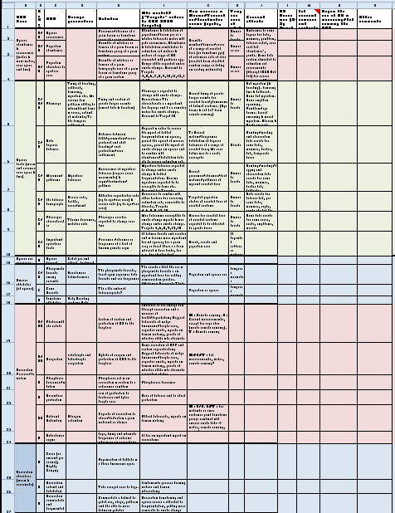
Essential Biodiversity Variables (EBVs)
National Aeronautics and Space Administration
NASA Biodiversity and Ecological Forecasting Team Meeting
Seattle
25-27 April 2012
Gary GELLER
NASA Ecological Forecasting Program
Jet Propulsion Laboratory
California Institute of Technology
(c) 2012 California Institute of Technology. Government sponsorship acknowledged.
Notes:
1
GEO BON is still a work in progress. And the ideas presented here on MRV for biodiversity are also still being formulated, but it does look like GEO BON can play an important role, just like it will play in helping CBD countries track progress toward their biodiversity goals. There may be similarities to both the CBD work, as well as UNFCCC (eg, the 3-tier approach)

Slide 2
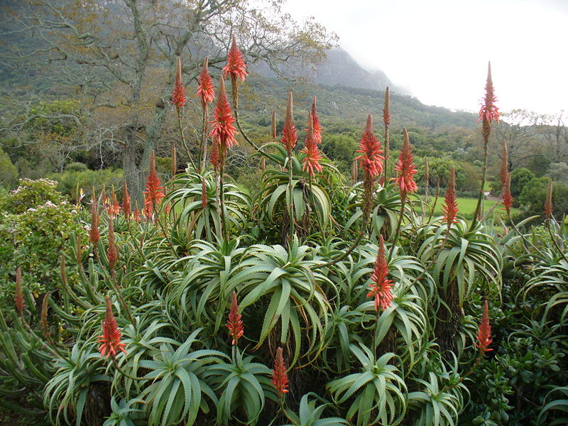
Overview
Background: Essential Climate Variables
EBV characteristics
Current EBV status
Breakouts
Wikimedia
commons

Slide 3
Essential Climate Variables
Purpose: Characterize climate and how it is changing
Examples
Temperature(s)
Precipitation
Water vapor, CO₂
Sea ice
Land cover…
Have high utility for the UNFCCC and IPCC analyses
Notes:
Atmosphere, ocean, terrestrial, about 50 in all

Slide 4
Essential Climate Variables
Developed by GCOS as part of their implementation plan
Updated on 5 year cycle
Highly successful, widely used
Guide observing system
Feed climate models
Enables IPCC assessments
Helps guide UNFCCC
Martin Wegmann via
Wikimedia commons
Notes:
Also, “blessing” a variable as an ECV gives it visibility and emphasis, highlighting it as a need

Slide 5
Would Essential Biodiversity Variables be equally useful and successful?

Slide 6
Who would they be for?
CBD signatory countries
IPBES
Policy makers, managers, researchers…
NGOs
Earth Observation community
Martin Wegmann via Wikimedia commons
Notes:
Purpose: (note—users below might use derived indicators, not necessarily the EBVs directly)
CBD: evaluation and reporting on progress towards 2020 targets
IPBES: Assessments
Policy makers, managers, researchers: information driving decisions and research directions
NGOs, to monitor progress towards their conservation goals
EO Community: identifying observational gaps

Slide 7
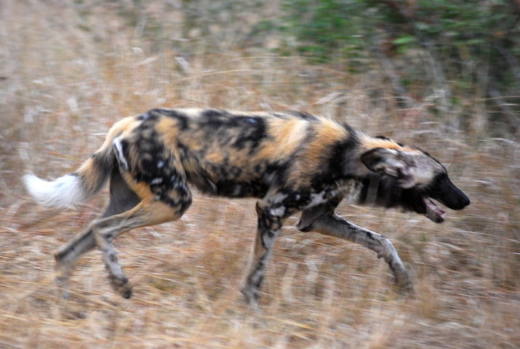
Activity
March 2011: Preliminary discussions
Concept Note
February 2012: EBV meeting
Concept paper
Initial EBV list
Ongoing: Discussions on additional development
Martin Wegmann via Wikimedia commons
Notes:
EBV meeting:
~35 participants, 3 days
Marine, freshwater, terrestrial; ecosystems, species, genes; RS and ground-based;
[Genes—subsumed into other areas]

Slide 8
EBV Examples
Ecosystem connectivity & fragmentation
Disturbance regime
Primary production
Phenology
Species occurrence
Population abundance
Allelic richness
…
Martin Wegmann via Wikimedia commons
Notes:
~30 total
Note: In these examples, all (except, perhaps, the first one) are generalizable to all habitats

Slide 9
Scope: What, exactly, is “essential”?
Challenging: many opinions…
Opted for “sufficient consensus”
Agreed that ~30 EBVs was good
Note 1: an EBV may have multiple parameters
Note 2: EBVs are more challenging than ECVs
Martin Wegmann via Wikimedia commons
Notes:
Balance among…Challenging because…
Everybody has their own opinion
Being complete and all-inclusive, vs do-able
Being 100% consistent, vs practical
Being perfect, vs getting it done and updating it
Should politics affect them, eg, including hot topics that are easily funded?
Multiple Parameters, eg phenology has timing of feeding, reproduction, migration….

Slide 10
Ideal EBV Characteristics
Biological
Important for understanding change
Technically and affordably feasible, now or soon
Generalisable—applicable to many forms of biodiversity
Focus on “state” variables (DPSR)
Notes:
Driver Pressure State Response

Slide 11
Primary vs Derived
Highly
Primary
Highly
Derived
(DBH)
(Ecosystem
Services)
Controversy!
Primary—measured “directly”
Derived—calculated or modeled using a variety of inputs
EBVs tend towards the Primary side
Controversy!
Notes:
Land cover—primary
Measures of ecosystem function—in between

Slide 12
Organizational Framework
Realm
Marine
Freshwater
Terrestrial
Levels of biodiversity
Ecosystem
Species
Genes
Ecosystem services

Slide 13
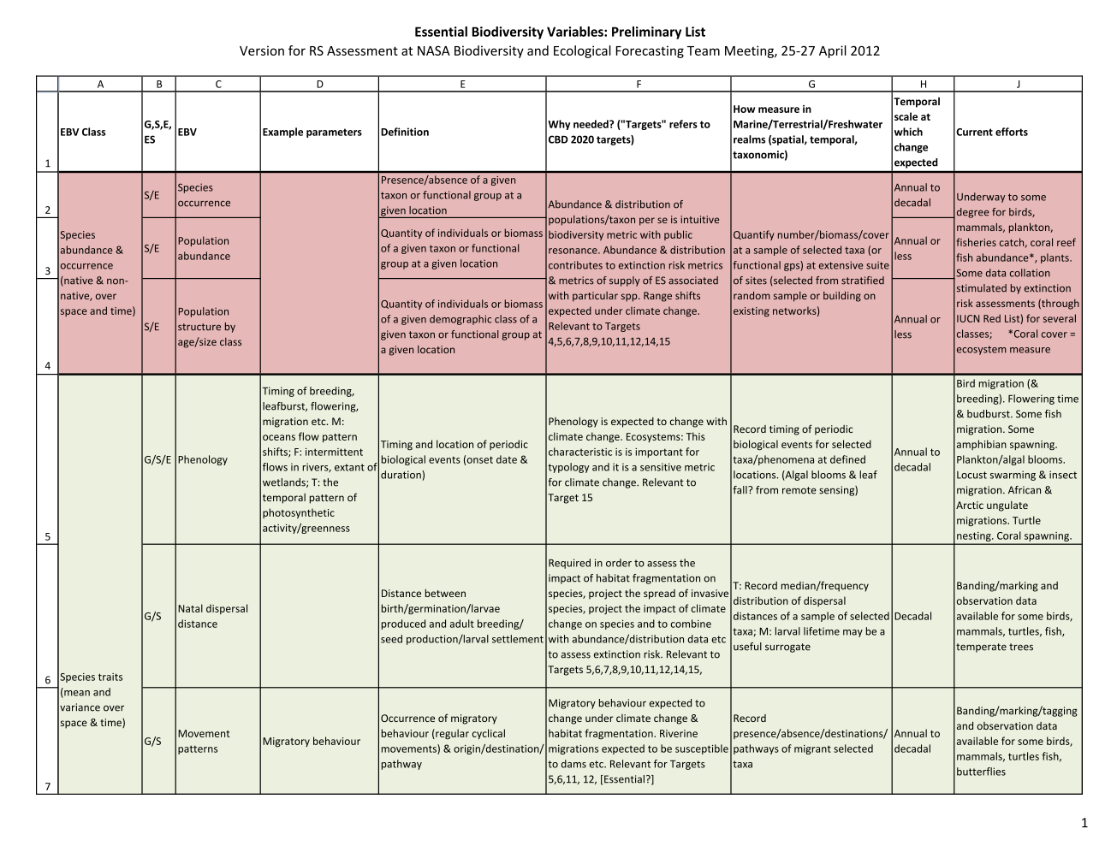
EBV Annotated List

Slide 14
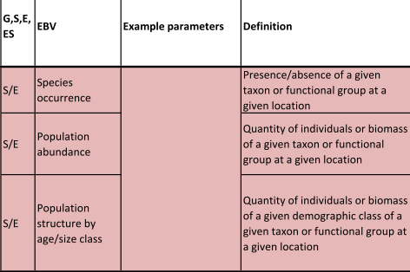
Species Abundance & Occurrence

Slide 15
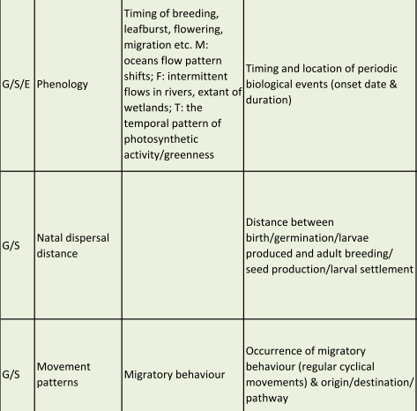
Species Traits (1)

Slide 16
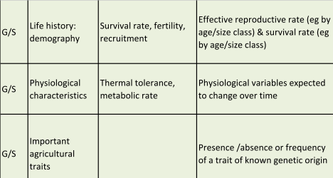
Species Traits (2)

Slide 17
Species Pressures + Species Ancillary

Slide 18
Ecosystem Process / Function (1)

Slide 19
Ecosystem Process / Function (2)

Slide 20
Ecosystem Structure

Slide 21
Ecosystem Composition

Slide 22
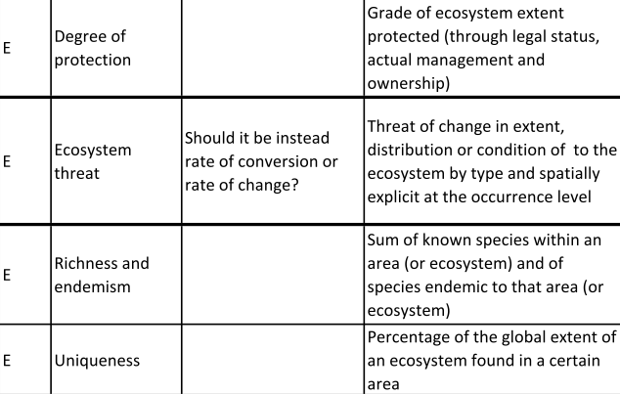
Ecosystem Response + Pressure + Ancillary

Slide 23
Ecosystem Services

Slide 24
Charge to Breakouts
Purpose
Identify the EBVs for which remote sensing could play a significant role
Why?
Clarify the role of RS in EBVs
Guide future NASA work
Used by NASA and the EBV developers
Notes:
Focus on the role for RS, not the EBV list itself.

Slide 25
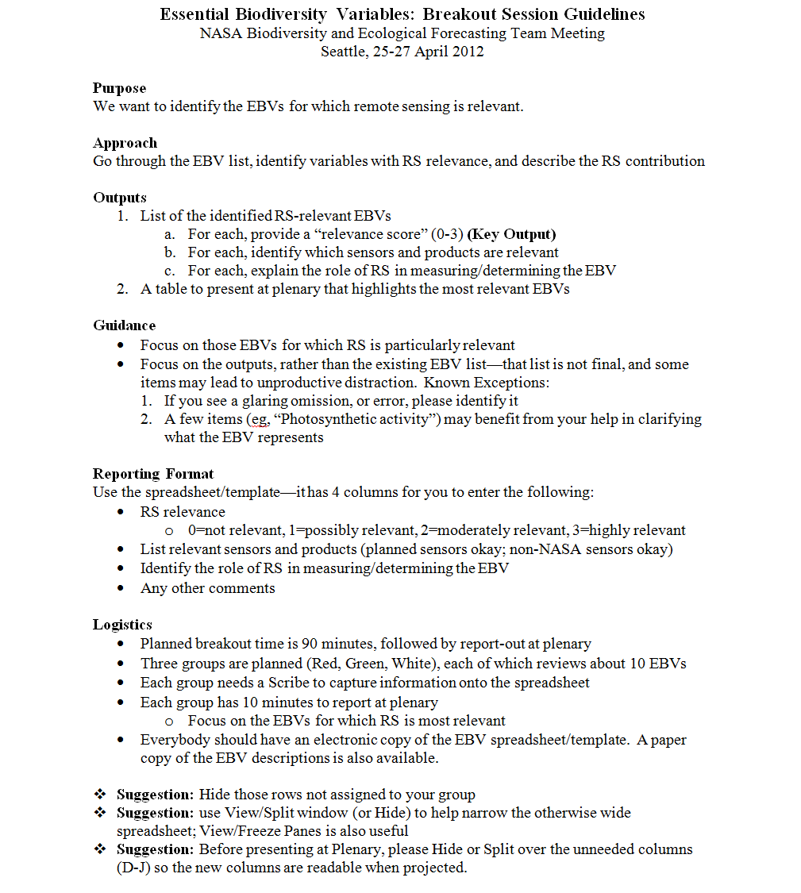
Breakout Guidance
Notes:
Note: The purely genetic EBVs have been hidden to make the number we deal with manageable.

